Slide 1
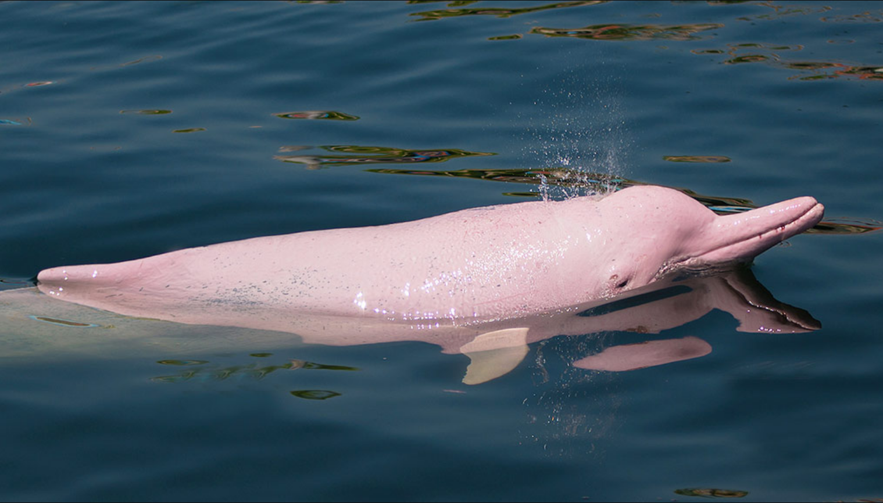
Amazon River Dolphin
Class 1.2 Leon
HPCX73603

Slide 2
Fact Sheet:
1: Appearance
2: Size
3: Lifespan & habitat
4: Diet

Slide 3
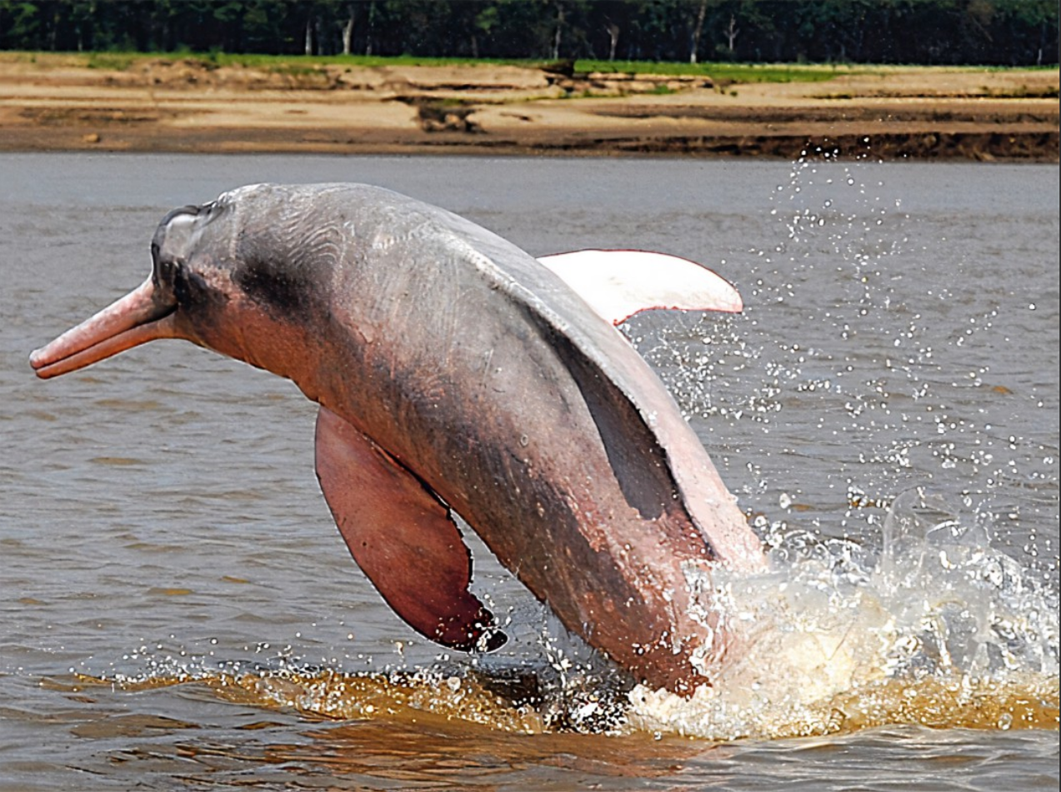
Appearance The color is usually gray Long and thin beak Small eyes
No dorsal fin
A flexible neck

Slide 4
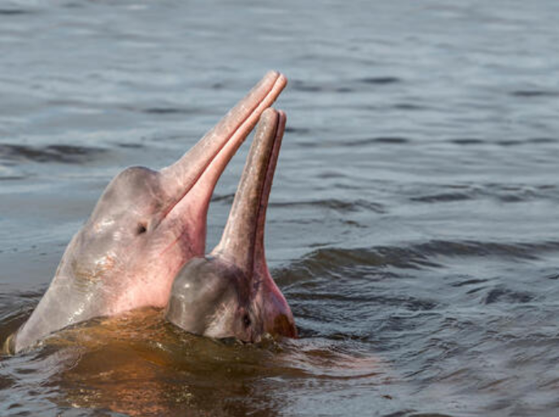
Size
The males are larger than the females

Slide 5
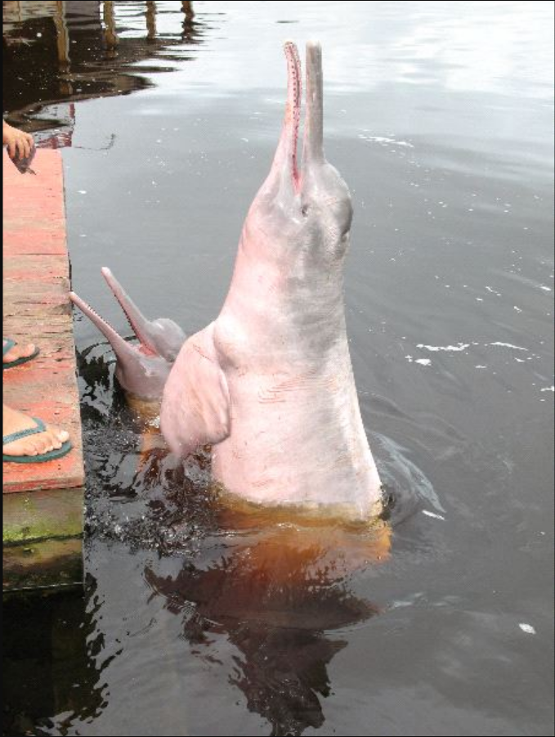
Lifespan & habitat
In the wild
Habitat
30 years
the Amazon and Orinoco rivers.

Slide 6
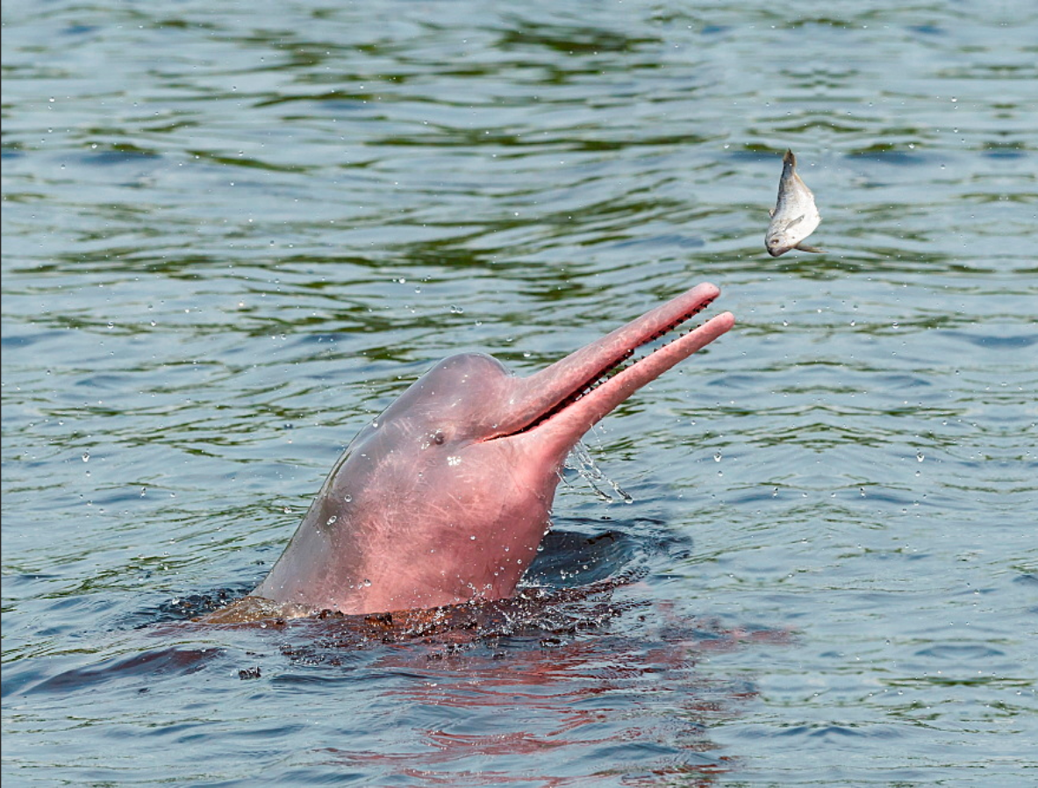
Diet
fish（More than fifty different species of fish）

Slide 7
Reference
“Amazon River Dolphin Facts.” WHALE FACTS, 11 July 2015, https://www.whalefacts.org/amazon-river-dolphin-facts/#
“Amazon River Dolphin.” BioExpedition, 16 Jan. 2020, https://www.bioexpedition.com/amazon-river-dolphin/#

